Slide 1
Openness and the capacity to learn Drs. Hans Schoo MBA-A, Chief Inspector Netherlands Health Care Inspectorate

Slide 2
The context of our work
28 laws
Thousands of guidelines (drawn up by care providers)
Healthcare budget: EUR 80 to 90 billion
1.2 million healthcare professionals
Over 40,000 locations
Notes:
The facts and figures in this slide provide some context to our work:
The Netherlands has no fewer than 28 laws concerning healthcare. We check if care providers comply with all the legislation that applies to them.
In addition to these laws, the care providers themselves have also drawn up thousands of guidelines. We also monitor if they comply with those guidelines.
The Netherlands has a massive healthcare budget. Healthcare is the biggest cost item for the Dutch government.
No fewer than 1.2 million people work in the care sector in one capacity or another. This is equivalent to approximately one care professional for every fourteen Dutch citizens. Many work in an organization, but the number of independent and/or self-employed healthcare professionals is increasing.
There are some 40,000 locations where care is provided. The total number of care organizations is smaller because they often run multiple locations. Nevertheless, it is the number of locations that matters to us, since quality and safety performance can vary considerably between locations run by a single organization.

Slide 3
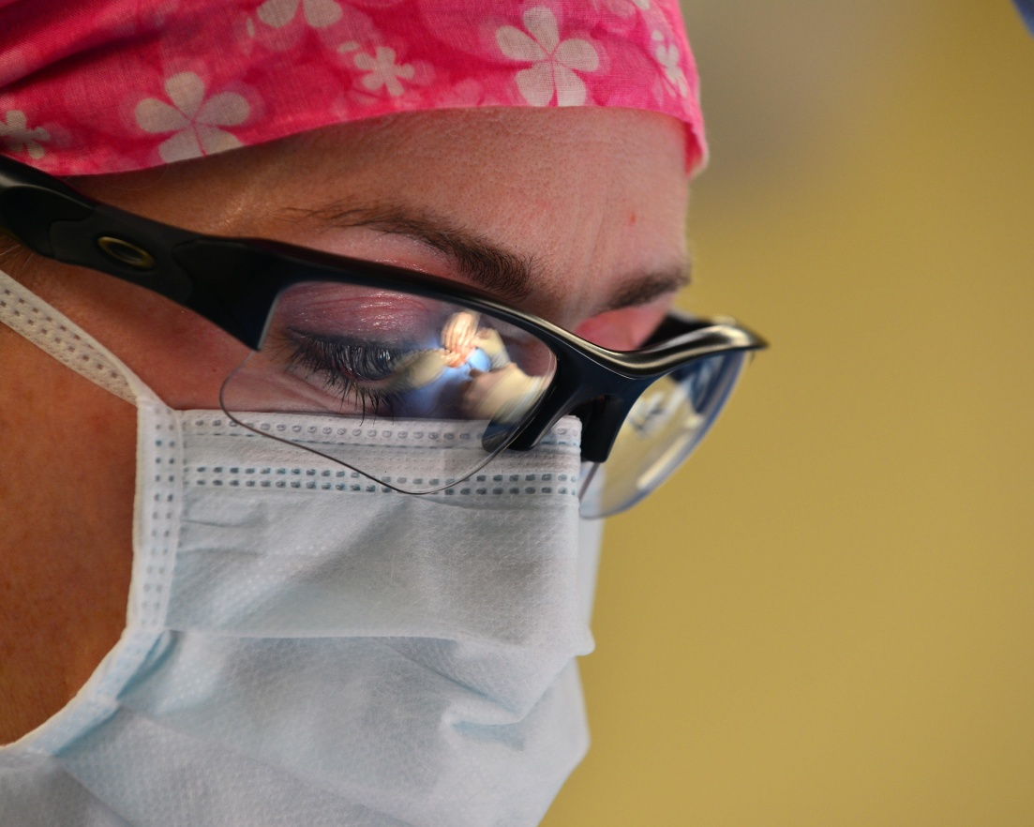
Mission
The Dutch Health Care Inspectorate (IGZ) monitors and promotes the safety and quality of healthcare by supervising care providers, enforcing applicable laws and regulations, and conducting investigations.
Ambition
Retaining and further developing an open culture of reporting incidents (adverse events).
Notes:
The Dutch healthcare system ranks among the best in Europe → must be preserved, also for future generations.
Transition from a predominantly supervisory role → to a role that also includes promoting safety and quality.
In that respect, we strive towards a broader movement towards openness. Being able to talk openly about what went wrong, or what makes you toss and turn at night requires a change of climate. A climate in which professionals discuss these incidents, report them to an internal committe on adverse events and eventually make the decision whether to investigate an event and/or to report it to the Health Inspectorate. Reporting an adverse event to the Health Inspectorate should never be motivated by fear. Nor should a decision not tot report an incident.
Professionals themselves need to be able and willing to reflect on a course of events, and the question ‘did anything go wrong and have we done something wrong?’ . Preferably in cooperation with colleagues, instead of with the Health Inspectorate.
In order to prevent anger, misunderstanding and uncertainty, we want patients and and their families to be involved in the resolution of an adverse event. With succes, because in 80 percent this is now the case; a fw years ago this was 10 percent.
Openness openness contributes to learning capacity
Maar: als alles wordt gemeld, betekent het niets meer.

Slide 4
Netherlands Health Care Inspectorate (IGZ)
Independent, impartial and transparent
We trust in the intrinsic motivation of care providers
We seek to achieve a balance between providing room to learn and taking measures
The perspective of patients is paramount
A Healthy Sense of Trust
Notes:
We perform our tasks as an independent body, while collaborating with all parties in the healthcare sector. We monitor the professional conduct of care providers and their boards of directors by ensuring that they comply with the applicable legislation and their own professional standards. We are transparent about the findings of our monitoring and supervision activities, where possible
We work on the basis of trust in care providers' intrinsic motivation to offer the best possible care. Unfortunately, errors and accidents cannot be entirely prevented in healthcare. In such cases it is important that the appropriate lessons are learned so that safety can be ensured and quality improved, with the ultimate aim of minimizing any negative health impacts and controlling risks more effectively.
We are continually adjusting our supervision and investigation activities to take account of new developments. We deploy our supervision capacity proactively in order to address the main risks in the healthcare sector, in an approach we call 'risk-based supervision'. Growing conviction: no lessons can be learned where fear reigns! →In the dynamic environment of the healthcare sector, we apply our core values of trust and transparency, while offering care providers the scope they need to learn and develop. However, if care providers are unwilling or unable to learn from their mistakes → strict enforcement measures
In performing our tasks, we have chosen to adopt the perspective of the citizen, who may fulfil the role of either patient or client. We regard the perspective of members of the public as paramount. How do they experience care, what are their expectations and experiences, what are their care outcomes? These questions guide our dialogue with the healthcare sector.

Slide 5
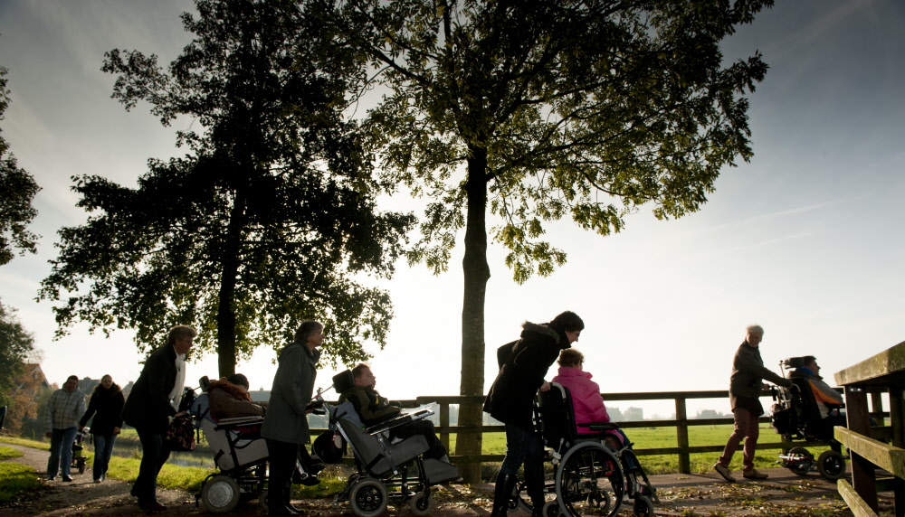
Intended results
Care geared to the patient/client
Safer care
Less (preventable) health damage
A fair and just culture
Increased learning capacity of health care institutions
Example
Avoidable mortality during surgical procedures decreased by 50% following introduction of 'time-out‘
Increase in patient/family involvement (less than 20% in 2013; over 70% in 2016)
Notes:
Professionals themselves need to be able and willing to reflect on a course of events, and the question ‘did anything go wrong and have we done something wrong?’ . Preferably in cooperation with colleagues, instead of with the Health Inspectorate.
In order to prevent anger, misunderstanding and uncertainty, we want patients and and their families to be involved in the resolution of an adverse event. In this respect we’ve been succesful. Nowadays, in over 70% of all cases patients and/or their families are involved; just a few years ago this number stood at just 10%.
Under these conditions, openness increases the learning capacity of institutions.
However: if everything gets reported, then what is the significance of these reports?

Slide 6
Development of patient safety
Healthcare Quality,
Complaints and Disputes Act
2015
Act on Quality of Health Care 1995
To err is human
1999
Transparency in adverse events and results
2016
Reporting adverse events
2005
It’s the result that counts
2004
Involvement of patients and their family
2014
Points of improvement, is there a learning effect?
2016
Notes:
We used to mainly pay attention to the medical aspects of cases. Was blood pressure correctly measured? Was attention being paid to the deterioration in the patient’s condition, etc. Nowadays, we also focus on context: how could this have happened? How is that analysis being made by the hospital and what do they learn from it? But also: is the patient being involved? The health care sector has evolved in this respect, the health care inspectorate as well. The legal framework is following suit.
Since 2015 mandatory reporting of adverse event → what is an adverse event? Open dialogue with the sector (‘dialogue sessions’)

Slide 7
Openness
Motto = a healthy sense of trust
Openness versus public accessibility
Being in control of your own message
Changing legal framework
Notes:
What does a healthy sense of trust mean? Trust is – in essence- a paradox. It is a way to cope with the fact that one can never know and/or understand everything.
Movement towards openness/public accessability is only going to be fruitful if the sector joins it
This is in the interest of the sector itself. Media and politicians will always call for increased openness/public accessibility. That is a given. It’s better to stay in control of your own message.
New act on quality of health care that is now being discusses in parliament calls for more public accessibility (all reports of adverse events public, taking into account privacy of patients and caregivers)
Pilots: general overview of reported adverse events, with information on patient involvement, follow up care, measures taken, etc.
This in the hope that this will stimulate health care institutions to strive for more openness themselves.

Slide 8
Results: patient involvement
Notes:
Yes = it is clear that patient was involved
No = it is clear that patient was not involved
Unknown = It is unclear whether patient was involved. For example: the report does not explicitlyy state that patient was involved, but does contain information that originates from te patient.
Not applicable = For example: patient did not want to be involved, or patient died and has no relatives

Slide 9
Results:follow up care

Slide 10
A call to action: take matters into your own hands
Notes:
Mooie stichtelijke eindboodschap!

