Slide 1
Incident disclosure and the prevention and support of second victims
Dr. sc. med. Stuart McLennan
Institute for History, Ethics and Philosophy of Medicine
Hannover Medical School
The Third International Incident Disclosure Conference
“Towards Operational Strategies”
20-21 October 2016

Slide 2
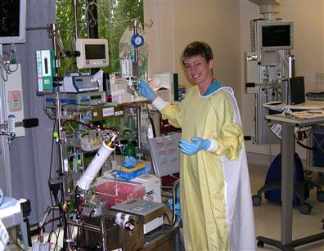
Case Study

Slide 3
Case Study
“She was in such anguish, she ran out of coping skills.”

Slide 4
Overview
1. Second Victims
Impact of Errors on Clinicians
Support After an Error
Factors Predicting Increased Distress
2. Implications for Organisations
Importance of error disclosure support
Ability to take time off
Clinicians “suffering in silence”
Dedicating Necessary Resources
Available Tools

Slide 5
Second victims
“Second victims” introduced to highlight significant emotional impact of errors.
Estimated 10%-43% of clinicians are left “second victims”

Slide 6
Impact of Errors
 | Waterman et al. 2007 | McLennan et al. 2015
Anxiety about future errors | 61% | 51%
Confidence in ability | 44% | 45%
Ability to sleep | 42% | 36%
Job satisfaction | 42% | 32%
Professional reputation | 13% | 9%

Slide 8
Support Following Errors
 | Waterman et al. 2007 | McLennan et al. 2015
Hospitals adequately support after errors (disagree). | 90% | 90%
Interested in psychological counselling | 82% | 92%
Reasons for not seeking counselling: Unable to take time off work | 43% | 34%

Slide 9
Predicting Increased Distress
1. Increased anxiety
Department
Female > Male
Serious error involvement
Dissatisfied with last disclosure
2. Loss of confidence
Department
Serious error involvement
Increased with age

Slide 10
Key findings
Distress is common, even after a minor error or near miss
Vast majority disagree healthcare organisations are adequately support them.

Slide 11
Implications for Organisations
Importance of error disclosure support
Ability to take time off
Clinicians “suffering in silence”
Dedicating Necessary Resources
Available Tools

Slide 12
Implications for Organisations
Error Disclosure Support
Australian Open Disclosure Framework
Principle 5: Health service organisations should create an environment in which all staff are:
encouraged and able to recognise and report adverse events
prepared through training and education to participate in open disclosure
supported through the open disclosure process

Slide 13
Implications for Organisations
Taking Time Off
“significant financial, logistical and personnel implications”

Slide 14
Implications for Organisations
Clinicians “suffering in silence”
Joesten et al. (2014): only 10% to 30% reported that support was actively offered to them after an incident

Slide 15
Implications for Organisations
Dedicating Necessary Recourses
“…Not only have these institutions embraced the concept of second victims, but they have also dedicated resources and time to establish safe delivery systems that help the healthcare provider.” (Edrees & Federico, 2015)

Slide 16
Implications for Organisations
Tools for Organisations
Medically Induced Trauma Support Services (MITSS)
Tools for Building a Clinician and Staff Support Program
http://www.mitss.org/

