Slide 1
Incident disclosure in the Netherlands: where do we stand?
Arno Akkermans
Berber Laarman
Vrije Universiteit Amsterdam
Notes:
Quote: “If you handle it the right way, the unforgivable can be forgiven” by a complaintsofficer.

Slide 2
We have come a long way since ‘the conspiracy of silence’…
KNMG (2006): A guideline by the professional association of doctors stipulating how to handle medical incidents
GOMA (2013): A code of conduct of health care providers, hospital management, legal representatives and medical liability insurers
Wkkgz (2016): Legal duty of candor in case of adverse events. Obligation to proactively record incidents and promptly inform patients about adverse events

Slide 3
New legislation: Wkkgz (2016)
“law on quality, complaints and disputes in health care”

Slide 4
New legislation: Wkkgz (2016)
‘Incident’: a not intended or unexpected event relating to the quality of care, which
has let to injury
could lead to injury
could have lead to injury
of the patient
Duty to establish formal
procedure to proactively
discover and record
all incidents
[N.B.: in addition to longer standing duty of analysing and reporting to Health Care Inspectorate of ‘catastrophic incidents’, i.e death or severe injury]

Slide 5
New legislation: Wkkgz (2016)
‘Incident’: a not intended or unexpected event relating to the quality of care, which
has let to injury
could lead to injury
could have lead to injury
to the patient
Proactive duty to
promptly inform
patients
Not in case of
‘near misses’

Slide 6
New legislation: Wkkgz (2016)
On request care provider must inform patient of his rights
Mandatory to have a ‘complaints officer’ (even though the act doesn’t use this term)
In case of a ‘complaint’ (might include claim): care provider must inform patient on his decision on the complaint/claim and the follow up within max. 10 weeks

Slide 7
New legislation: Wkkgz (2016)
In case of a dispute on complaint/claim, patient can resort to a low threshold tribunal
Tribunal to be jointly established by care providers and patients organizations
Tribunal can decide on complaints and on claims up to at least € 25.000
Vast majority of
cases in NL

Slide 8
GOMA (2013)
“Code of conduct for open disclosure and the better resolution of medical malpractice claims”

Slide 9
GOMA (2013)
Broadly supported code of conduct, drafted on basis of input of wide range of stakeholders in Dutch health care
Aimed at candor after medical error and low conflict out of court resolution of medical malpractice claims
Currently under revision in order to bring in line with latest developments (including Wkkgz)

Slide 10
GOMA (2013)
Drafting and revision process perhaps equally important as result
Participation by all relevant parties not only guaranties quality and practicability
But also creates awareness, involvement and commitment

Slide 11
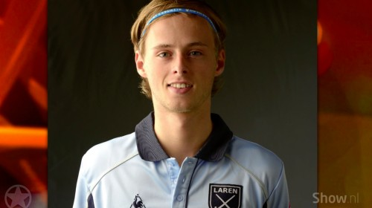
In the mean time…

Slide 12
The will is there, but where is the way?
In search of operational strategies for a better response to medical incidents and a better resolution of medical malpractice claims
Researchers and health care professionals working closely together: a form of Participatory Action Research (PAR)
Notes:
In 2013 the VU conducted research into the needs of patients and shortcomings of the process of medical practice systems. The needs of patients can be summed up as such:
These needs of patients are met through the process of what is called ‘open disclosure’ or ‘incident disclosure’. Disclosure is not a one way provision of information, it is a process, a discussion that may take place in several meetings over a period of time.
What’s the problem? A ‘disclosure gap’ exists: the way hospitals/healthcare professionals react after an adverse event, falls short of what patients want, need and expect of their doctor. This leaves patients not only physically disadvantaged, but also feeling abandoned and powerless against the doctor who used to be their caretaker & was supposed to make them better. In this context, we tend to speak of the ‘incident after the incident’. (kan mooier) Instead of minimizing the possible damage, the way hospitals and/or caretakers tend to react after events is exacerbating the effect the incident has on the overall wellbeing of the patient.
Research (Vincent et al, 2000) has shown that one of the main reasons patients sue their doctors, is the lack of information and guidance after something goes wrong → use of legal procedures as a weapon of last resort, instrument to win back control in situation of feeling powerless. → effect of legal procedures on mental and physical health.

Slide 13
https://www.dss.gov.au/our-responsibilities/housing-support/publications-articles/homelessness-youth/on-par-using-participatory-action-research-to-improve-early-intervention?HTML

Slide 14
OPEN: Open and fair handling of complaints and incidents in health care
OPEN is a learning network of 12 avant garde hospitals, researchers of NIVEL, Vrije Universiteit Amsterdam, and the University of Amsterdam/Amsterdam Medical Centre
Network meetings
Website: www.openindezorg.nl
Notes:
In comes project OPEN: It is a change agent and a research project. By collaborating with 12 hospitals who are motivated to stimulate an open environment we as researchers are able to gain insight in the way being open can be organized. By sharing our knowledge, on our platform www.openindezorg.nl, network gatherings and through our research report, hospitals can learn from each other.

Slide 16
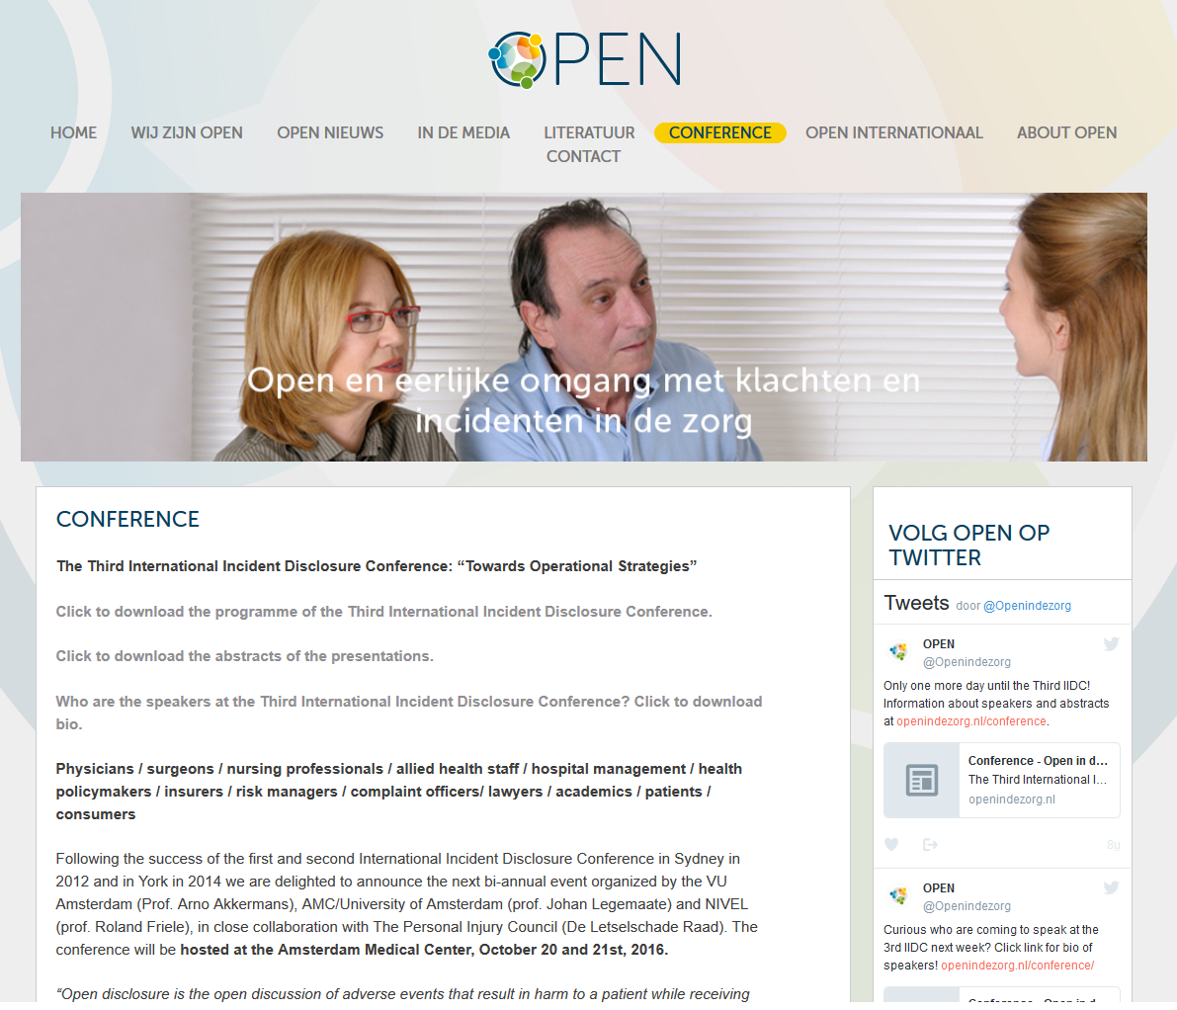

Slide 17
Some preliminary findings of one year of OPEN

Slide 18
Laarman et al (2016)
http://hdl.handle.net/1871/54415
(in Dutch)

Slide 19
The healthcare professional can’t do it on his own
“We do find that doctors tend to be lonely in what they experience.”
“If you’re experiencing a lot of emotions, you can’t be open properly, I think.”
“Some doctors inflict more damage due to the way they handle the disclosure conversations”
Notes:
Problem: Healthcare professional as a second victim can’t (always) be expected to properly disclosure incidents to patients.
Problem: it has to happen fast (24 hours), but it also has to happen adequately. Is it always possible to prepare?
Practice: peer support. This responds to the problem of healthcare prof as second victims, but it doesn’t address the difficulties professionals face in how to talk to patients.
Peer support such doesn’t necessarily lead to an open attitude towards patients. Someone needs to guide the professional in how to talk to patients. Support in this stage is rare.

Slide 20
The healthcare professional can’t do it on his own
Problem: Healthcare professional as a second victim can’t (always) be expected to properly disclosure incidents to patients
Problem: communication has to happen fast (24 hours), but it also has to happen adequately. Is it always possible to prepare sufficiently?
Notes:
Problem: Healthcare professional as a second victim can’t (always) be expected to properly disclosure incidents to patients.
Problem: it has to happen fast (24 hours), but it also has to happen adequately. Is it always possible to prepare?
Practice: peer support. This responds to the problem of healthcare prof as second victims, but it doesn’t address the difficulties professionals face in how to talk to patients.
Peer support such doesn’t necessarily lead to an open attitude towards patients. Someone needs to guide the professional in how to talk to patients. Support in this stage is rare.

Slide 21
The healthcare professional can’t do it on his own
Practice: peer support. This responds to the problem of healthcare profs as second victims, but it doesn’t address the difficulties professionals face in how to communicate with patients.
Peer support as such doesn’t necessarily lead to an open attitude towards patients. Someone needs to guide the professional in communication with patients. Support in that stage is rare.
Notes:
Problem: Healthcare professional as a second victim can’t (always) be expected to properly disclosure incidents to patients.
Problem: it has to happen fast (24 hours), but it also has to happen adequately. Is it always possible to prepare?
Practice: peer support. This responds to the problem of healthcare prof as second victims, but it doesn’t address the difficulties professionals face in how to talk to patients.
Peer support such doesn’t necessarily lead to an open attitude towards patients. Someone needs to guide the professional in how to talk to patients. Support in this stage is rare.

Slide 22
(after) Care for patients
“We do it all because of patients, but sometimes the patient himself gets forgotten…”
Notes:
Problem: Participants in OPEN signaled a need for someone who keeps in touch with the patient. Hospitals work hard to improve patient safety by creating a ‘just culture’, where professionals report events and events are discussed in order to learn from them. But due to the emphasis on an open environment to learn from incidents, sometimes the patient get lost out of sight. Being open is not only important because the educational aspect, it is also a patient right and a goal in itself.
Practice: Casemanagement for patients. Experimental phase, first results are promising.
Practice: Proactive complaints officer who assumes these responsibilities.

Slide 23
(after) Care for patients
Problem: Participants in OPEN signaled a need for someone who keeps in touch with the patient. Hospitals work hard to improve patient safety by creating a ‘open culture’, where professionals report events and events are discussed in order to learn from them
But due to the emphasis on an open environment to learn from incidents, sometimes the patient gets out of sight
Notes:
Problem: Participants in OPEN signaled a need for someone who keeps in touch with the patient. Hospitals work hard to improve patient safety by creating a ‘just culture’, where professionals report events and events are discussed in order to learn from them. But due to the emphasis on an open environment to learn from incidents, sometimes the patient get lost out of sight. Being open is not only important because the educational aspect, it is also a patient right and a goal in itself.
Practice: Casemanagement for patients. Experimental phase, first results are promising.
Practice: Proactive complaints officer who assumes these responsibilities.

Slide 24
(after) Care for patients
Being open is not only important because the educational aspect, it is also a patient right and a goal in itself
Practice: ‘Case management’ for patients Experimental phase, first results are promising
Practice: Proactive ‘complaints officer’ (contradictio in terminis) who takes responsibility
Notes:
Problem: Participants in OPEN signaled a need for someone who keeps in touch with the patient. Hospitals work hard to improve patient safety by creating a ‘just culture’, where professionals report events and events are discussed in order to learn from them. But due to the emphasis on an open environment to learn from incidents, sometimes the patient get lost out of sight. Being open is not only important because the educational aspect, it is also a patient right and a goal in itself.
Practice: Casemanagement for patients. Experimental phase, first results are promising.
Practice: Proactive complaints officer who assumes these responsibilities.

Slide 25
The role of leadership
Expressing being open as a cultural norm
Money, time and personnel to meet the needs of being open
Initial care for the professional when something goes wrong
Positioning the right person in the process

Slide 26
A comprehensive policy
“It is a complex combination of different things. You can’t say, I will start with peer support, and then I will think about disclosure. You have to decide up front how you want to organize it”

Slide 27
A comprehensive policy
One of the main findings of OPEN is that the preparedness to be open is not enough, its only a starting point
An open approach has to be organized
Hospitals need a comprehensive policy on what needs to be done on all three levels: patient, healthcare professional and executives

