Slide 1
Including Patient perspective in incident analysis
Prof. dr. Robert Slappendel
Safety and Quality of Care
Tilburg University, Netherlands
Chair department of anaesthesiology
University Hospital Antwerp, Belgium

Slide 2
Content
Patient experience
Using patient experience in malfunctioning of doctors
Using patient experience in analysis of severe incidents
Benefits for patients
Case reports

Slide 3
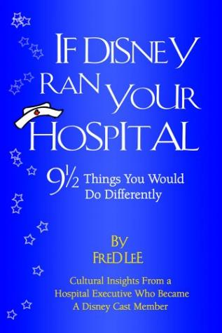
1. Patient experience

Slide 4
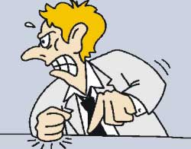
1. Patient experience
Claims (insurer)
Complaints, formal (committee)
Complaints, accessible (Complaints Officer)
Complaints that are not expressed
Patient satisfaction scores

Slide 5
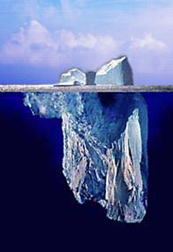
1. Patient experience: The IceBerg
Amphia Hospital: > 600.000 patient contacts
Claims 40
Formal complaints 50
Accessible complaints 1800
When you ask (25x) 45000
Unexpressed complaints (x50) 90000
Patient satisfaction score 7,5

Slide 6
How can we use patient experience?
Claims
Formal complaints
Accessible complaints
Unexpressed complaints
Patient satisfaction scores

Slide 7
Accessible complaints
How can we use patient experience?
Examples:
accessibility,
treatment,
Disclosures
information
discuss complaints,
appointments,
putative error,
aftercare.

Slide 8
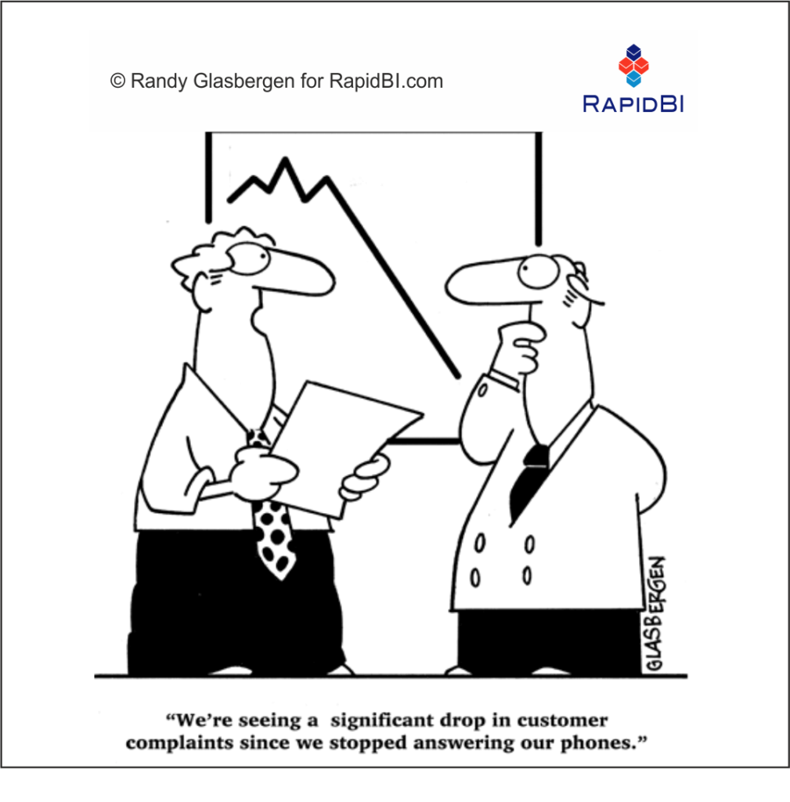
Accessible complaints
How can we use patient experience?
We’re seeing a significant drop in complaints since we stopped answering our phones

Slide 9
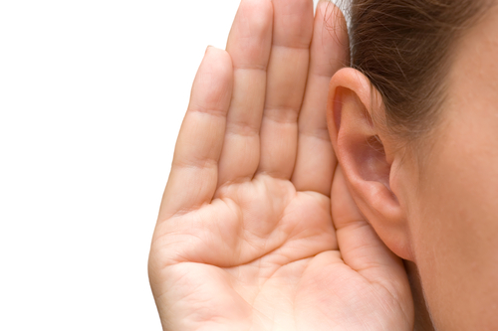
Accessible complaints
How can we use patient experience?

Slide 10
Accessible complaints Malfunctioning

Slide 11
Accessible complaints ? Malfunctioning

Slide 12
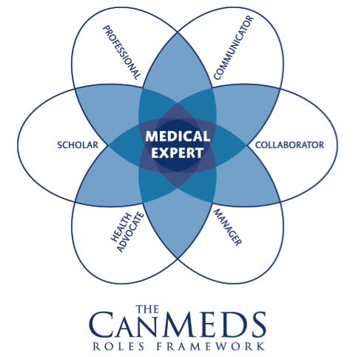
CanMEDS criteria

Slide 13
CanMEDS criteria

Slide 14
Results: Individual complaints professionals
250 complaints / professional / year
250 professionals
Average 1 / year

Slide 15
A Board monitor to recognize malfunctioning professionals
Prof. dr. Robert Slappendel, Anesthesiologist
Manager Quality and Safety
Amphia Hospital Breda
Netherlands

Slide 16
Complaints overview 2009-2012
 |  | Number complaints | % professionals | % complaints
1 | Below average | 0-5 complaints | 64% | 25%
2 | Above average | 6,7, of 8 complaints | 25% | 40%
3 | >2 x average | 9,10 of 11 complaints | 8% | 23% | Specialty group
4 | > 3 x average | ≥12 complaints | 3% | 12% | Board

Slide 17
Results
7 complaints = 1 claim (P<0,001)
In every speciality

Slide 18
Results
7 complaints = 1 claim (P<0,001)
5 professionals fired,
4 of them were in top 10 of complaints monitor

Slide 19
Conclusion
Complaints malfunctioning
It could be an early signal of malfunctioning
No time effort
No extra registration
Appreciates the input of the patient

Slide 20
3. Using patient experience in analysis of severe incidents

Slide 21
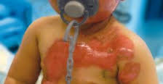
Severe incident 2009
Young child during surgery almost completely burned by wrong connection heating mattress.
3rd degree burns over whole body,
Several cosmetic treatments were needed

Slide 22
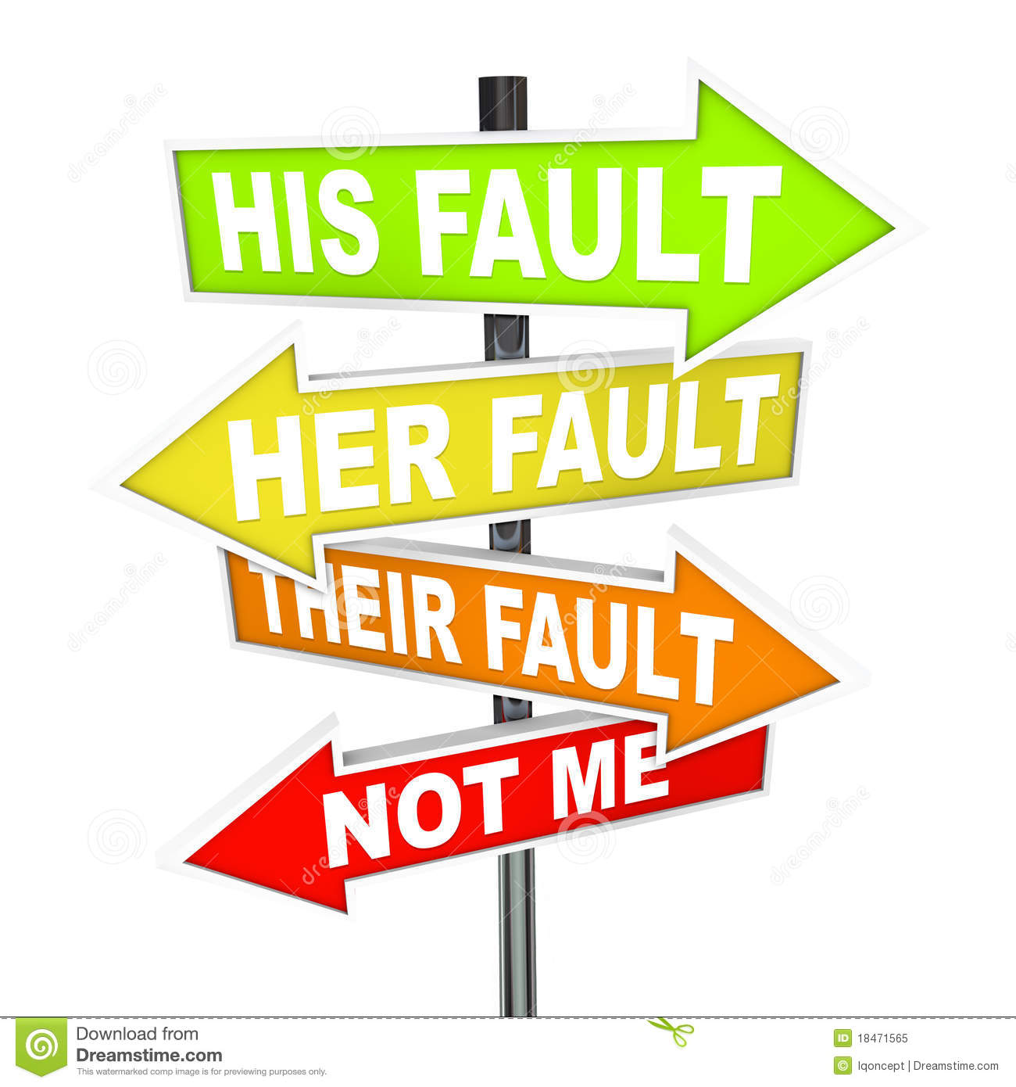
Follow-up care by our Doctors
Appointment at an outpatient clinic of surgeon as "control" patients (10 minutes).
During conversation the doctor was called away (2x)
Communication: "It was not my fault,”
“It was a mistake of the anaesthetist.”

Slide 23
Follow-up care by our Doctors 2 months later
Appointment in consultation with anaesthesiologist.
The anaesthesiologist forget the appointment
Re-appointment after 3 weeks….

Slide 24
Result
Parents have long-term resistance to hospital
Hospital liability was made, a very lengthy settlement
The story came in the local newspaper

Slide 25
Result
Lifelong physical and emotional trauma for parents and child
Negative image for physicians and hospital

Slide 26
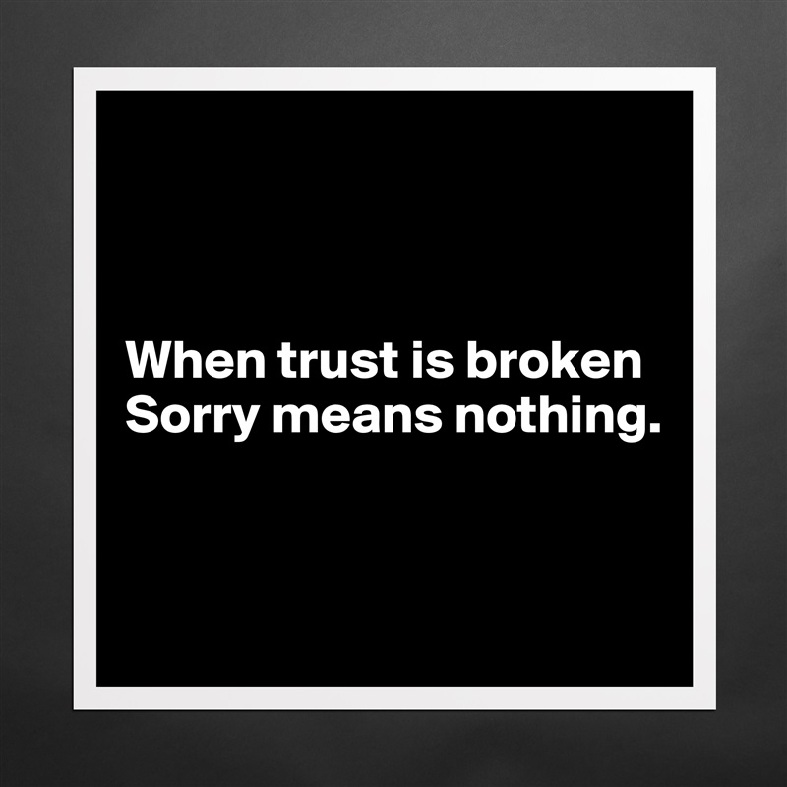

Slide 27
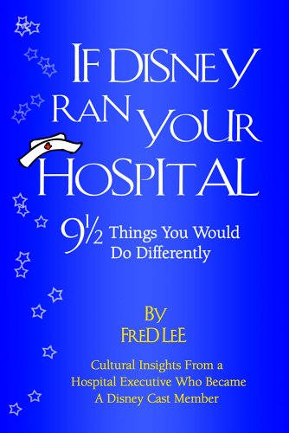
Restore trust
Inform
Explain
Think of something that goes far beyond the expectations of people

Slide 28
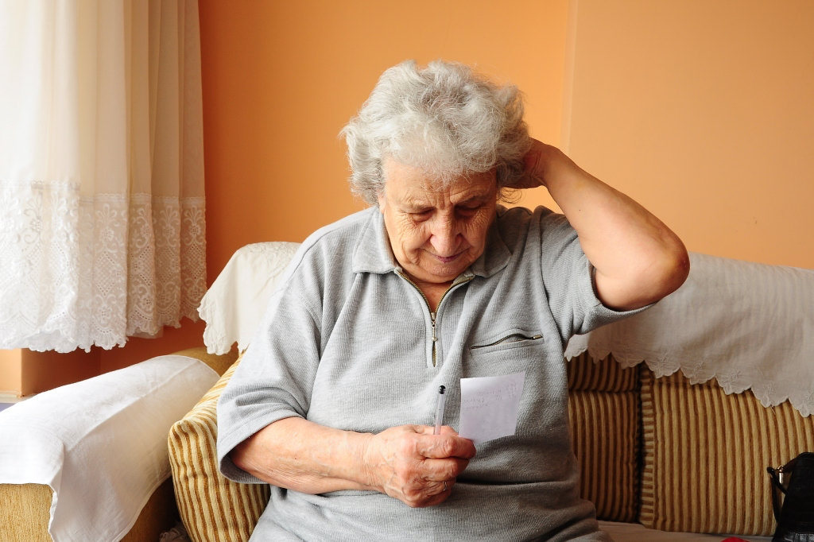
HoW?
Visit the patient or related family at their home!
Ask how they have experienced the incident.
Explain how you analyse their incident

Slide 29
HoW?
Ask if they have any questions and answer those questions in the analysis.
Explain the outcome of the final report (note medical terminology)
Explain what the hospital (or doctors) do different next occasion.

Slide 30
Direct Benefits
Patients are heard!
Involved, survivors receive answers to all questions.

Slide 31
Direct Benefits
This method takes less time, while all negative correspondence will stop.

Slide 32
Direct Benefits
No more claims that have no chance.

Slide 33
Direct Benefits
Almost all parties understand that "mistakes" can be made if they understand how it occurred.

Slide 34
Direct Benefits
People appreciate if improvement measures avoid same incidents in future

Slide 35
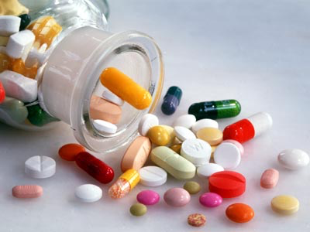
A final case report

Slide 36
A final case report
A suicide attempt of a 46y old women
She was found at the countryside with severe undercooling
She was referred to our hospital for warming the body

Slide 37
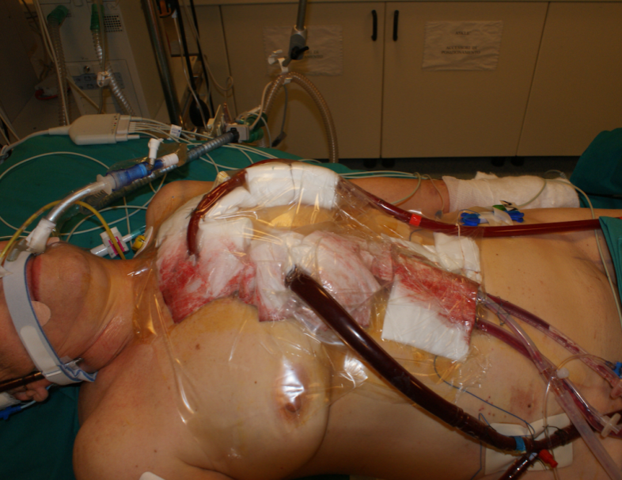
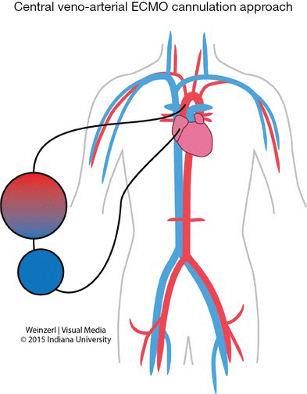
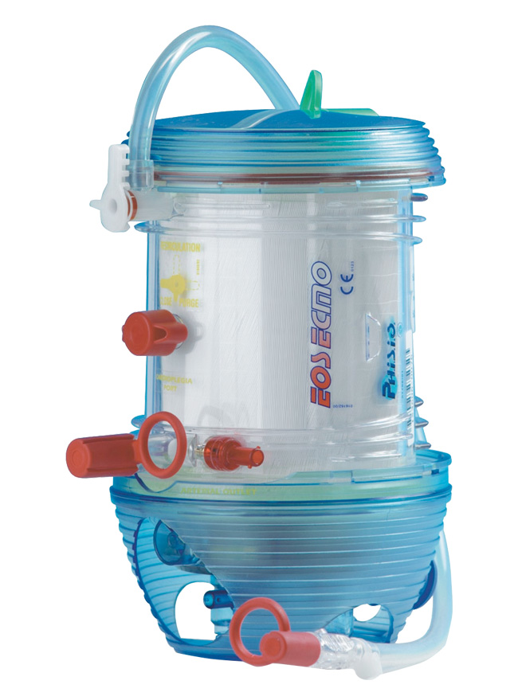
A final case report
She was treated was with ECMO (extra corpereal membrane oxygenation)

Slide 38
A final case report
She was safely warmed up slowly in 2 days
All vital parameters were OK
The ECMO device could be removed!

Slide 39
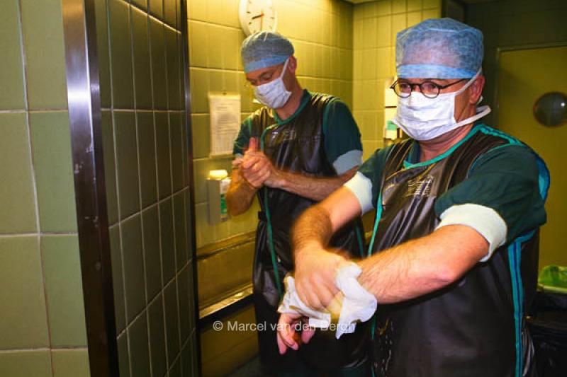
A final case report
Removal at the operating theatre
By a qualified heart surgeon
He removed the adhesive plaster
And he was going to was his hands for surgery (3 min)

Slide 40
A final case report
Then the incident became clear
While the surgeon removed the plaster, the blood cannula was removed a little and came outside the vein.
During 3 minutes all blood was pumped inside the body.
There was no blood anymore in the heart and the patient died within 3 minutes

Slide 41
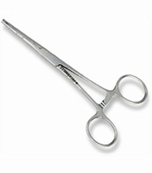
A final case report
During our analysis we found this surgeon never works with the ECMO device
He wasn’t trained with the device, but he feels himself capable
If he blocked the cannula by a clip, the patient survived
It’s the first rule in training of ECMO….

Slide 42
A final case report
We informed and explained everything to the relatives.
They understand why this mistake was made.
They understand it was a real mistake.
They understand our improvement measure.
They had only one question???

Slide 43
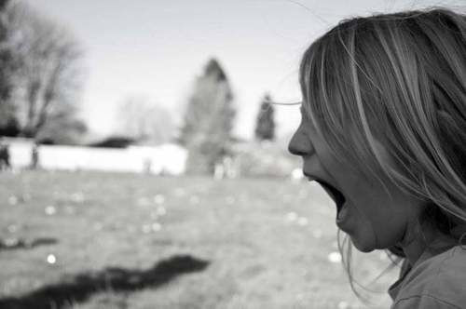
A final case report
Why let the psychiatric hospital her go on weekend leave?

Slide 44
A final case report
Why the psychiatric hospital let her go on weekend leave?
Can you get any information about it??
We made the contact with the psychiatry.

Slide 45
A final case report
The psychiatric hospital never informed
The psychiatric hospital never explained
They get a big financial claim
We got roses from the family
All our surgeons were trained in ECMO treatment

Slide 46
final conclusions
Restore trust
Inform
Explain
Think of something that goes far beyond the expectations of people

